Slide 1




Outcomes of the
Second Asia-Pacific
Regional Review of the Global Compact for Migration (GCM)
Sabine Henning, Ph.D.
Chief, Sustainable Demographic Transition Section Social Development Division, ESCAP
Phumza Manqindi
Senior Regional Liaison and Policy Officer
Policy and Liaison Unit
Regional Office for Asia and the Pacific
International Organization for Migration, IOM
Pakistan, United Nations Network on Migration Lauch
1 September 2025, hybrid

Slide 2
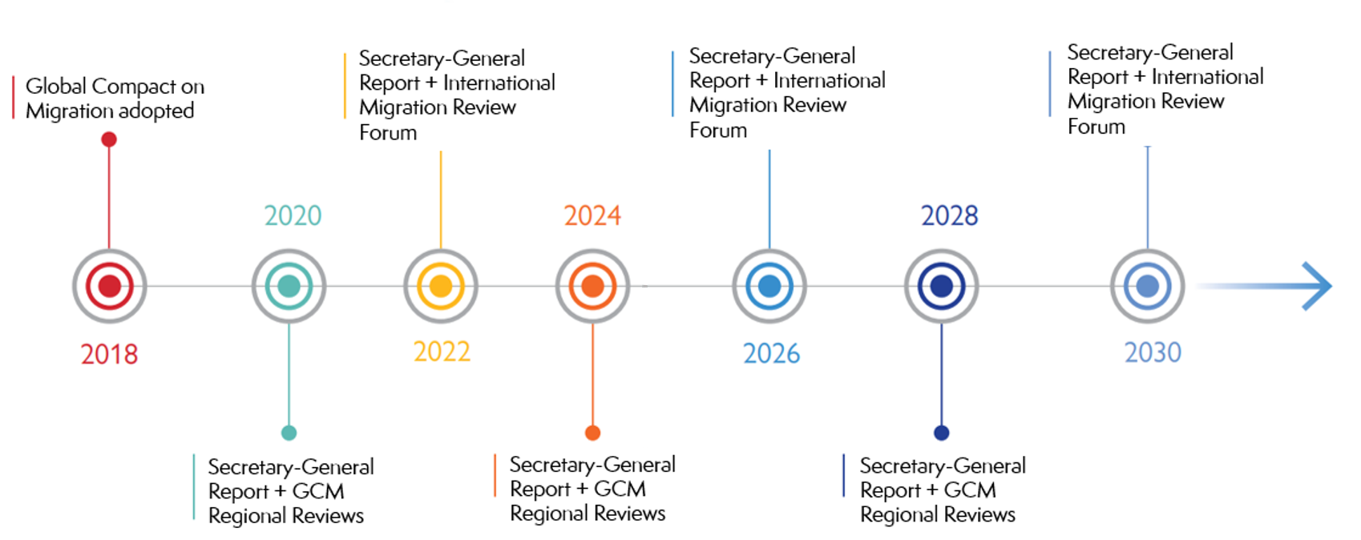


GCM follow-up and review
Timeline

Slide 3
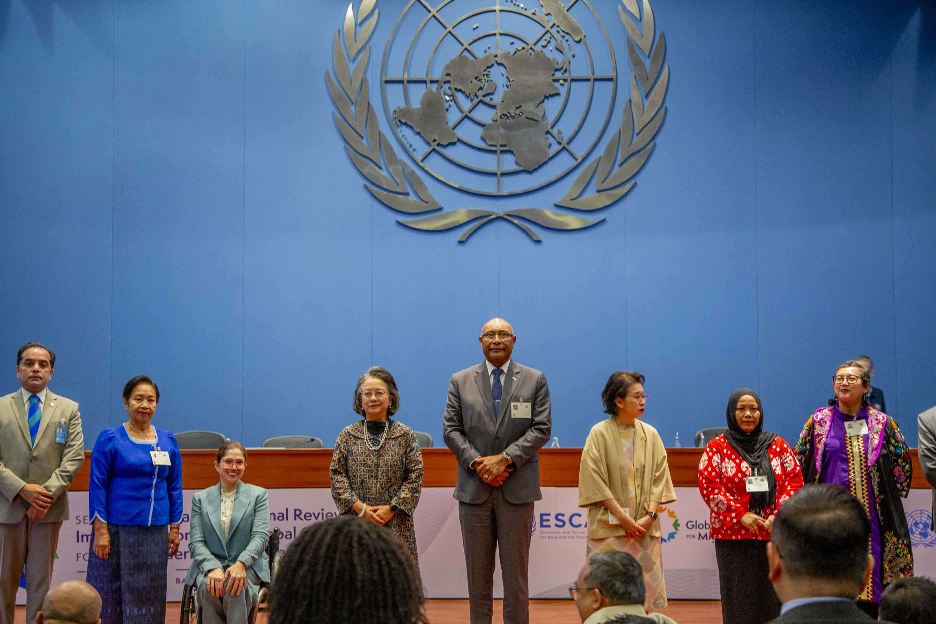
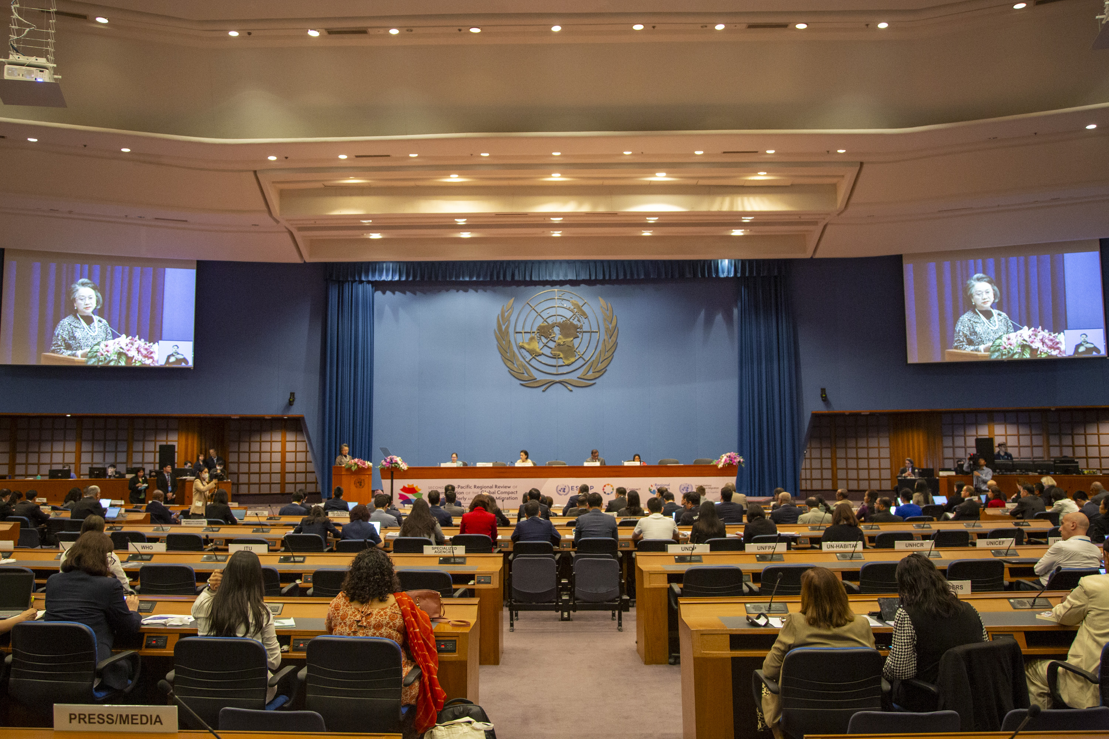

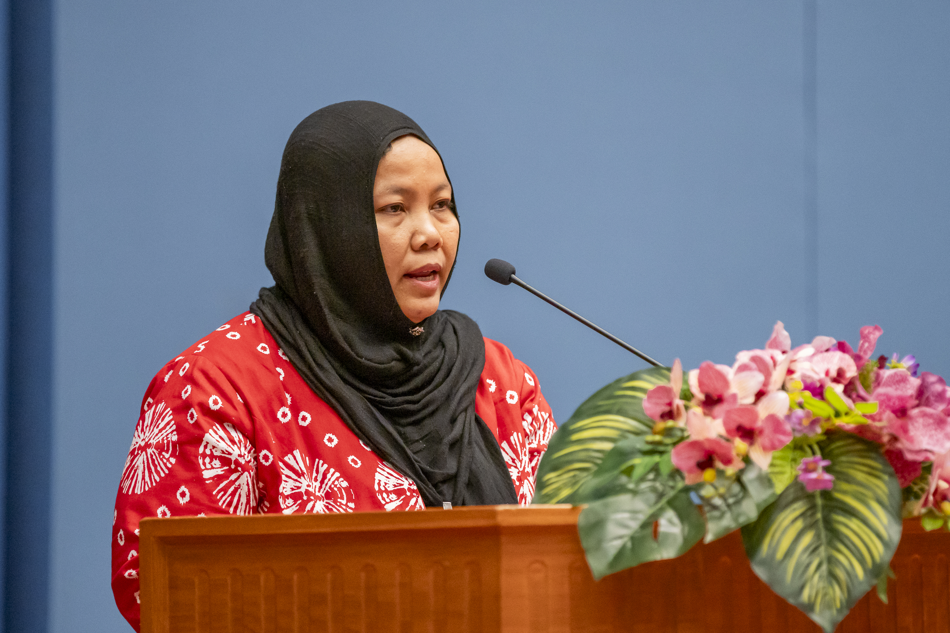
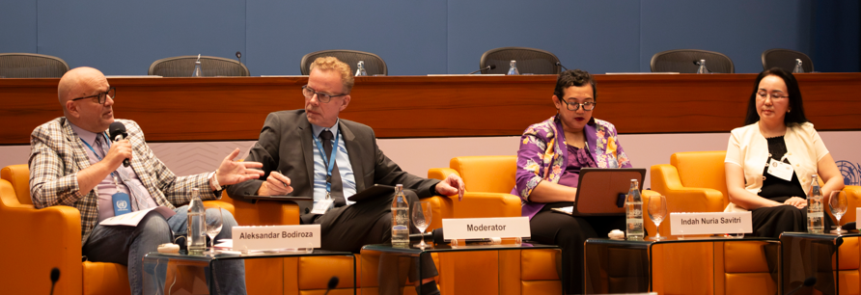
Event summary
Dates and location:
4-6 February 2025 + Stakeholder Forum (3 Feb.)
Attendance:
30 ESCAP member States and 10 observers
120 intergovernmental organizations, United Nations bodies, civil society organizations and other entities (among them, about 100 stakeholder organizations)
Bureau:
Chair: Mr. Viliame Naupoto (Fiji)
Vice-Chairs:
Ms. Chou Bun Eng (Cambodia)
Mr. Faiyaz Murshid Kazi (Bangladesh)
Ms. Indah Nuria Savitri (Indonesia)
https://www.unescap.org/events/2025/second-asia-pacific-regional-review-implementation-global-compact-safe-orderly-and

Slide 4
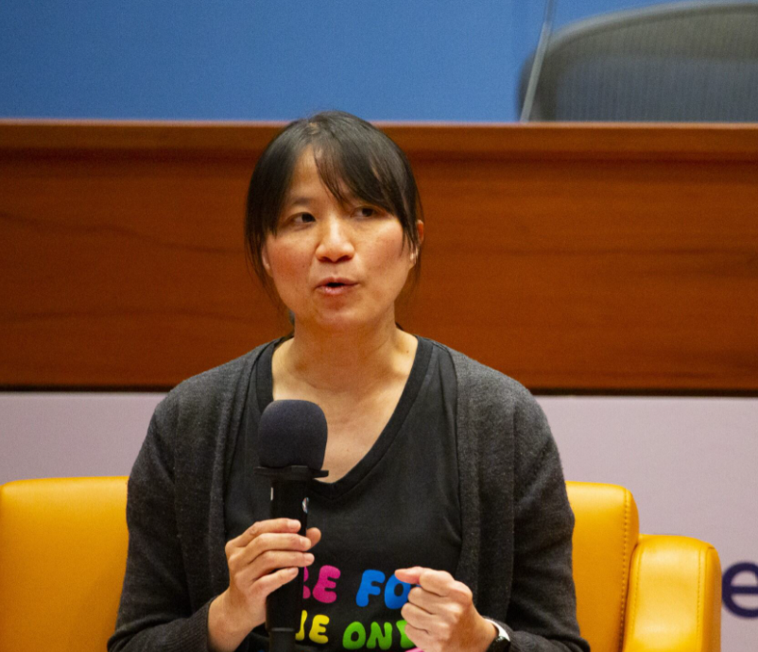


Parliamentary documents
Review of progress and challenges with regard to implementing the Global Compact
for Safe, Orderly and Regular Migration in Asia and the Pacific - ESCAP/GCM/2025/2
Linking the Global Compact for Safe, Orderly and Regular Migration and the 2030 Agenda
for Sustainable Development in the context of international migration in Asia and
the Pacific - ESCAP/GCM/2025/3
Reports on stakeholder consultations on the Second Asia-Pacific Regional Review
of Implementation of the Global Compact for Safe, Orderly and Regular Migration
ESCAP/GCM/2025/4
High-level panel, round tables, side events and special event
High-Level Panel on Regular Pathways for Migration
4 Round tables
Ensuring that migration is voluntary, safe, orderly and regular
Protecting migrants through rights-based border governance
Supporting migrants’ protection, integration and contribution
to development
Improving value-driven and evidence-based policymaking and public debate, and
enhancing cooperation on migration
19 Side events, including special event

Slide 5
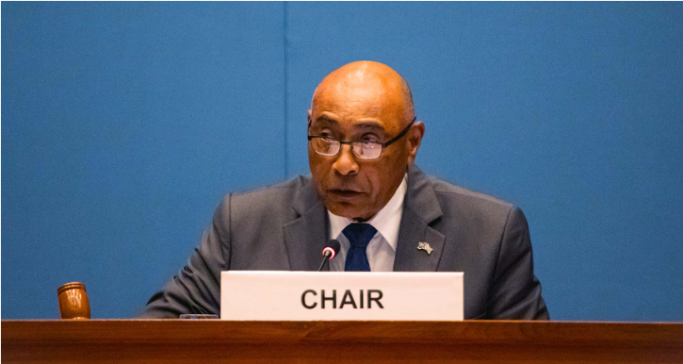
Report of meeting, including Chair’s summary (ESCAP/GCM/2025/5)
Labour migration and rights:
Migrants fill labour market gaps, contribute to innovation and improve business practices. Countries reported on their efforts in harmonizing skills recognition, establishing gender-responsive policies and lowering remittance costs.
Unethical recruitment, exploitation, and limited access to protection mechanisms remain a concern.
Regular pathways must be created to reduce vulnerabilities and recruitment costs. Ratification and implementation of ILO conventions and human rights standards crucially important.
Rights-based migration governance:
Migrant smuggling, trafficking in persons and irregular migration are growing concerns, greater subregional and regional coordination in combating transnational crimes and trafficking is needed.
Despite using evidence-based public discourse to shape perceptions of migration, xenophobia remains a concern, and it is crucial to include human rights standards in all migration-related policies.
GCM implementation must be gender-responsive.
Climate change and migration:
Intersection of climate change and migration have become an increasing concern, and millions of people are forced to migrate abroad due to climate change, disasters or conflict. Climate change posed an existential threat that transcended boundaries.
Climate change has a disproportionate impact on migrant workers, who required access to more environmentally friendly, decent jobs.
Policies to address climate-induced migration are needed, including resilience and adaptation measures.

Slide 6
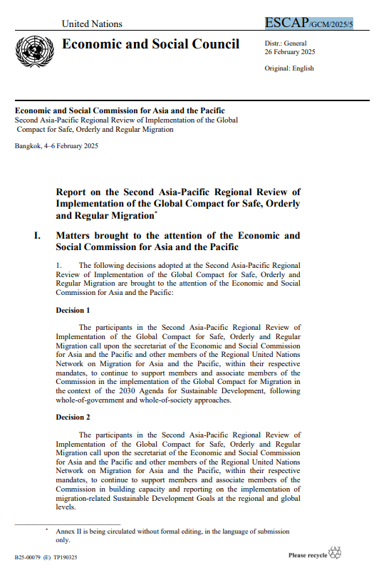
Report of meeting, including Chair’s summary (ESCAP/GCM/2025/5)
Other cross-cutting issues
Contribution of migrants to sustainable development in countries of origin, destination and transit important.
Statelessness to be eradicated and provision of basic education and access to services important for migrant children, and Alternatives to immigration detention crucial.
Strengthening of national systems for collecting, analyzing and dissemination data important; monitoring frameworks important in this regard
Work of the UN Network on Migration to support Governments in GCM implementation, including through capacity-building important
Whole-of-government and whole-of-society approach to GCM implementation crucial
Regional cooperation and partnerships on international migration key
Decision 1
Participants called on ESCAP and the UN Network on Migration to continue supporting countries in implementing the GCM following whole-of-government and whole-of-society approaches.
Decision 2
Participants called on ESCAP and the UN Network on Migration to continue supporting countries in building capacities and reporting on migration-related SDGs.

Slide 7








Stakeholder engagement
1 October 2024 | Consultation 1: Supporting migrants’ protection, integration and contribution to development Co-organized by Stakeholder Advisory Group & UNDP
30 October 2024 | Consultation 2: Protecting migrants through rights-based border governance Co-organized by Stakeholder Advisory Group & OHCHR
19 November 2024 | Consultation 3: Pacific Stakeholder Consultation Co-organized by Stakeholder Advisory Group & IOM
28 November 2024 | Consultation 4: Ensuring that migration is voluntary, orderly and regular Co-organized by Stakeholder Advisory Group & ILO
4 December 2024 | Consultation 5: Improving value-driven and evidence-based policymaking and public debate, and enhancing cooperation on migration Co-organized by Stakeholder Advisory Group & ESCAP
3 February 2025 | Stakeholder Forum
Reports of stakeholder consultations:
https://www.unescap.org/events/2025/second-asia-pacific-regional-review-implementation-global-compact-safe-orderly-and

Slide 8


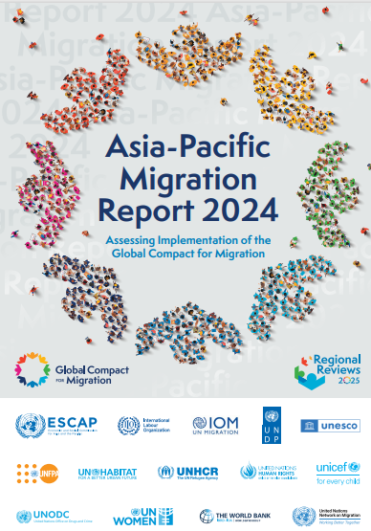

Asia-Pacific Migration Report 2024
Purpose: Evidence base for the Second Asia-Pacific Regional Review of Implementation of the Global Compact for Migration (GCM) in 2025
Objective: Asia-Pacific UN system-wide assessment of the implementation of the Global Compact for Migration – 23 objectives, 10 interdependent guiding principles – across all ESCAP subregions, ESCAP members and associate members
Time frame: 2020-2024 (taking stock since the Asia-Pacific Migration Report 2020)
Contributors: 13 UN entities in Asia and the Pacific + review by experts, including non-government stakeholders

Slide 9
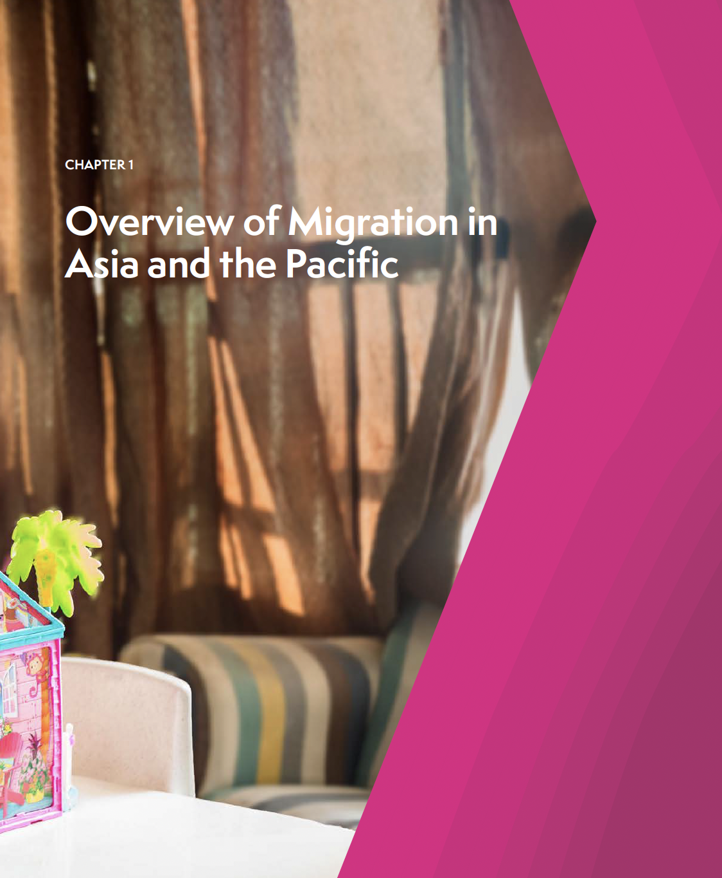
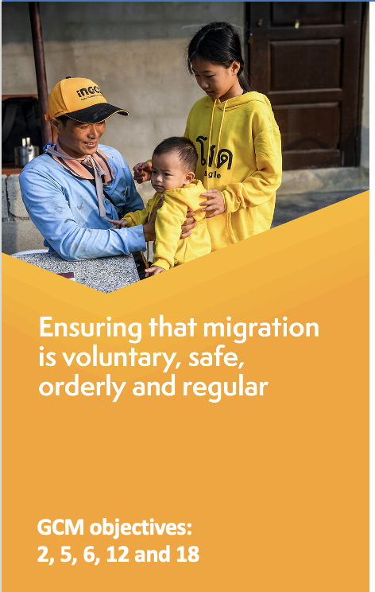

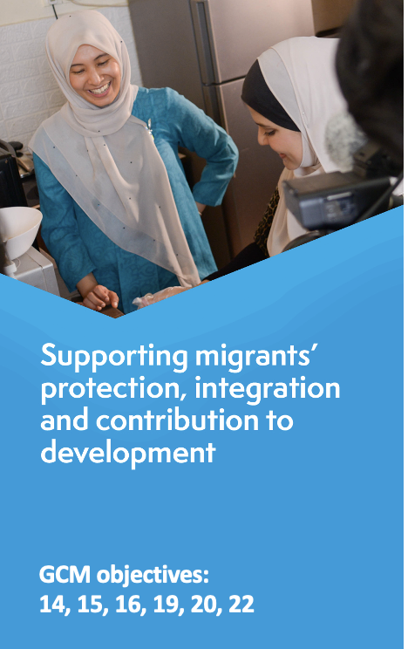
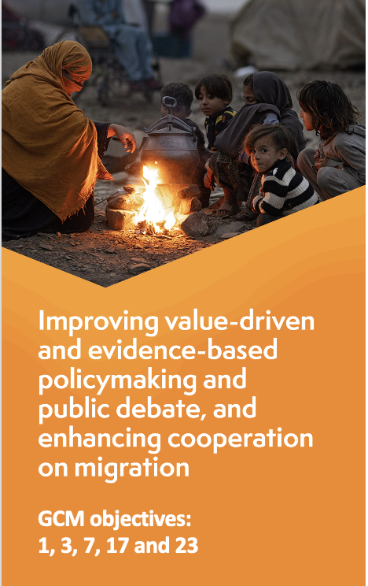
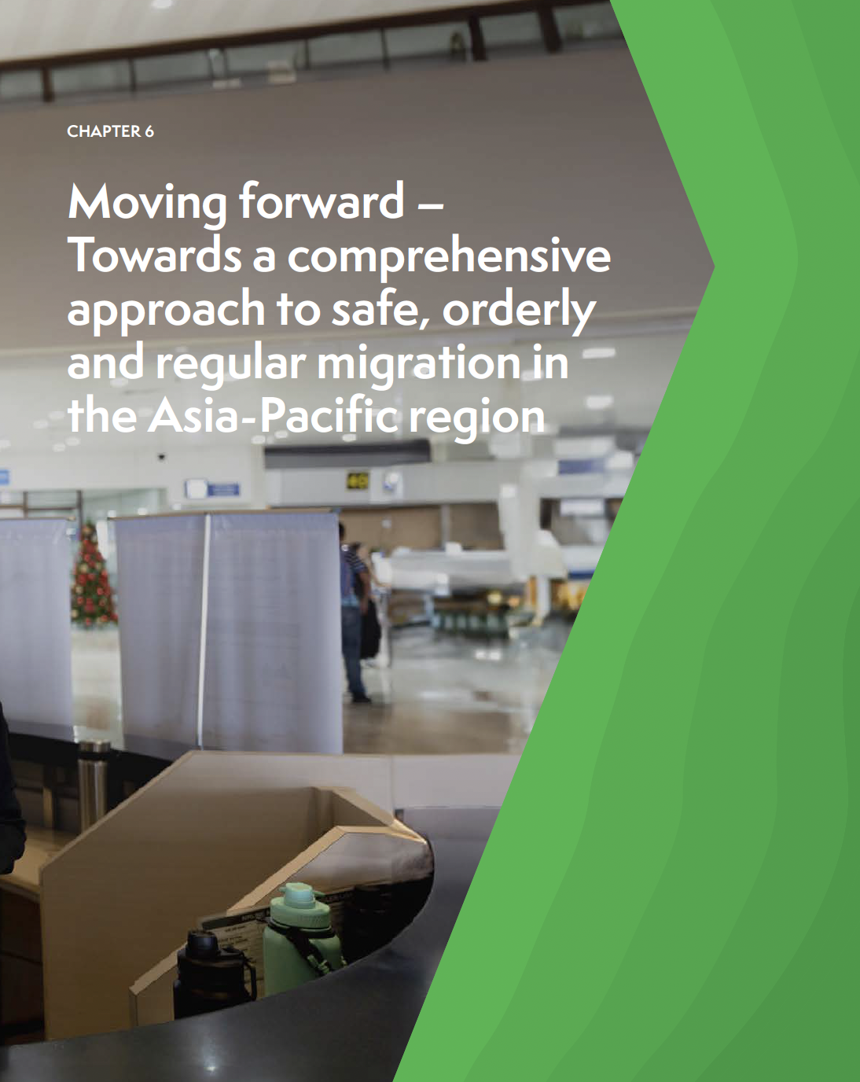


Asia-Pacific Migration Report 2024
Chapters of the reports are grouped under four key thematic clusters of the GCM + overview + conclusions and recommendations
Chapter 1
Chapter 2
Chapter 3
Chapter 4
Chapter 5
Chapter 6
https://repository.unescap.org/server/api/core/bitstreams/00fe2ffd-5e46-41ec-b33a-97c90f5e9b2e/content

Slide 10

International Migration Review Forum (IMRF)
Primary intergovernmental global platform for Member States to discuss and share progress on the implementation of all aspects of the Global Compact, including as it relates to the 2030 Agenda.
Held every four years
Results in a Progress Declaration
Sets the agenda for the next years of GCM implementation

Slide 11
Secretary-General Report (2025)
Biennial report to the General Assembly on the implementation of the GCM
Key features include:
Good practices presented by Member States and stakeholders during the Regional Reviews and submitted on the GCM Capacity Building’s Network Hub. These will inform the 2026 Secretary-General report.
Progress made by Member States and stakeholders in the implementation of GCM pledges.
The Report will be presented to Member States and stakeholders in February 2026 and inform the 2026 IMRF.
Access the 2024 Report here

Slide 12


National Voluntary GCM Reviews (GCMRs)
“We encourage all Member States to…conduct regular and inclusive reviews of progress at the national level… Such reviews should draw on contributions from all relevant stakeholders, as well as parliaments and local authorities, and serve to effectively inform the participation of Member States in the International Migration Review Forum and other relevant forums” GCM, para 53

Slide 13
National Voluntary GCM Reviews (GCMRs)
Member States are encouraged to develop GCMRs in line with the 360-degree vision and guiding principles of the GCM.
The Network, through regional and country Networks, stands ready to assist governments in conducting voluntary reviews of progress in the implementation of the GCM, including of the new mandates introduced following the first IMRF Progress Declaration.
The Network will assist governments, upon request, with technical assistance from the Demand-driven Facility of the GCM capacity-building mechanism, to measure progress against the GCM indicator framework presented by the Secretary-General in his 2024 report.
All relevant stakeholders, are invited to submit their inputs to the IMRF to the secretariat of the Network (unmignet@iom.int) after which they will be posted on Network’s website, prior to the IMRF.

Slide 14
Practices and Pledges
In the leadup to the second IMRF:
Member States and stakeholders are invited to submit further practices on the GCM capacity-building mechanism’s Network Hub.
Member States and stakeholders are invited to submit progress on their pledges and to consider submitting new pledges, whit a special focus on the Secretary-General’s recommendations on strengthening cooperation on missing migrants and providing humanitarian assistance to migrants in distress.
To that end, the Network will launch a call for practices and pledges in 2025.

Slide 15
Stakeholder Engagement
The PGA will organize and preside over one day of informal interactive multi-stakeholder hearings one day prior to each forum and will invite the representative of civil society to present a summary of the hearings during the opening segment of the IMRF.
The Network will support the Office of the PGA (OPGA) in the organization of the informal interactive multi-stakeholder hearing prior to the IMRF.
The Network will support the UN Secretariat and OPGA as regards stakeholder accreditation and registration.
A virtual cross regional stakeholder consultation is planned to take place in commemoration of the IMD 2025.

Slide 16
Proposed IMRF Roundtables and Policy Debate
Convened under the auspices of the General Assembly,
chaired by the President of the General Assembly
Day 1
Day 2
Day 3
Plenary – opening segment
Plenary – general debate
Day 4
Plenary – general debate
Plenary – closing segment
Progress Declaration adopted
Roundtables
Policy Debate
Roundtables
Roundtables
Day preceding the Forum
Informal interactive multi-stakeholder hearing
D R A F T
UNGA Resolution 73/326

Slide 17

Proposed Key Outcomes
Progress Declaration
Adopted by consensus
Renewed commitment to intensify efforts towards the collective goal of safe, orderly and regular migration
Called for:
  Limited set of proposed GCM indicators
  Actionable recommendations on strengthening cooperation on missing migrants
11
National Reviews
69
Pledges
Migration MPTF Contributions
D R A F T

Slide 18
For questions, please write to: escap-sdd@un.org

