Slide 1
Climate change and women’s livelihoods in Bangladesh, Nepal and Sri Lanka & Implications for ADD labour-receiving countries
Abu Dhabi Dialogue
30 September 2025
Ms. Tanja DEDOVIC
Senior Regional Thematic Specialist on Labor Mobility and Social Inclusion
Regional Office for Middle East and North Africa (MENA)

Slide 2






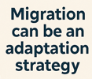


Introduction
Notes:
Today I will share initial findings from a research project that IOM is leading on climate change, women’s livelihoods, and migration.
We know that climate change is profoundly reshaping livelihoods and labour markets across the globe. Sectors like agriculture, tourism, and hospitality will experience significant transformation under the pressures of climate change and the global green transition. Many of these sectors employ a significant number of women.
Men and women experience these changes in different ways, due to their differing roles in society and the social or cultural factors that affect their access to assets, resources, and power. When their livelihoods are threatened, men and women have access to different coping strategies, as well as different opportunities to adapt to the impacts of climate change.
One adaptation method is migration. The type of jobs available, the migration experience itself, and the return experience are often very different for men and women.
This means that gender-specific approaches are critical.
My presentation today will look at how Skills Mobility Partnerships can be tailored to the specific needs and profiles of women, and help build resilience to the impacts of climate change.

Slide 3
Research objectives
The policy goal is to support the development of climate-smart, gender-responsive policies that enhance bilateral cooperation.
Objectives of the project
Assess the impacts of climate change on women’s livelihoods in Bangladesh, Nepal, and Sri Lanka;
Explore how skills mobility partnerships could increase employment of women migrant workers in emerging or high-demand sectors in the GCC sub-region;
Identify case studies that offer practical guidance and insights; and
Recommend policy interventions to support women’s economic resilience and well-governed labour mobility in the face of climate change.
Notes:
We are still in the early stages of the project, so today I will talk through the initial findings and how the project will be further developed. We will publish a policy brief early next year.
The policy goal of the research is to support the development of climate-smart, gender-responsive policies that enhance cooperation between ADD labour-sending and labour-receiving countries.
The research will pursue the following specific objectives:
Assess the impacts of climate change on women’s livelihoods in Bangladesh, Nepal, and Sri Lanka;
Explore how skills mobility partnerships could lead to increased employment of women migrant workers in emerging or high-demand sectors in the GCC sub-region;
Identify case studies that offer practical guidance and insights; and
Recommend policy interventions to support women’s economic resilience and well-governed labour mobility in the face of climate change.

Slide 4
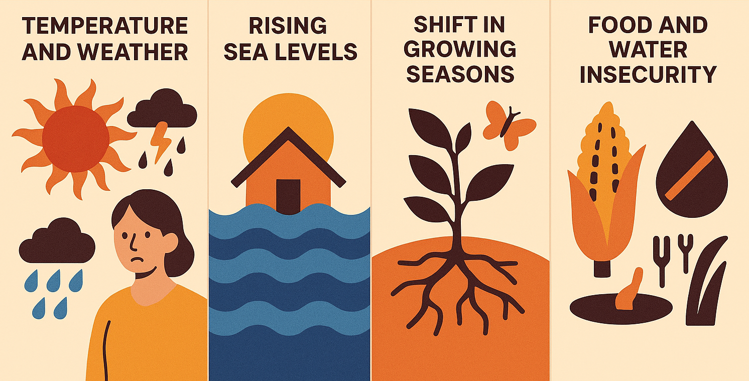
Climate change impacts in Asia
Notes:
The Asian continent is particularly vulnerable to climate change due to its high reliance on climate-sensitive livelihoods, high incidence of poverty and food insecurity, and high population densities in areas highly exposed to climate-related hazards.
The research will focus in on three labour-sending countries: Bangladesh, Nepal, and Sri Lanka, but first I will give an overview of climate change impacts across the Asian continent.
Key impacts are:
Temperature and Weather: Asia is heating up at twice the average global rate, leading to more frequent and intense heatwaves. This also brings more severe storms and increased drought conditions.
Rising Sea Levels caused by melting glaciers and ice caps, which pose a significant threats to coastal communities and ecosystems.
Ecological Shifts such as shifts in growing seasons, loss of habitats, and an increase in invasive species.
and
Food and Water insecurity as changing growing seasons and extreme weather events threaten food production and water management.

Slide 5
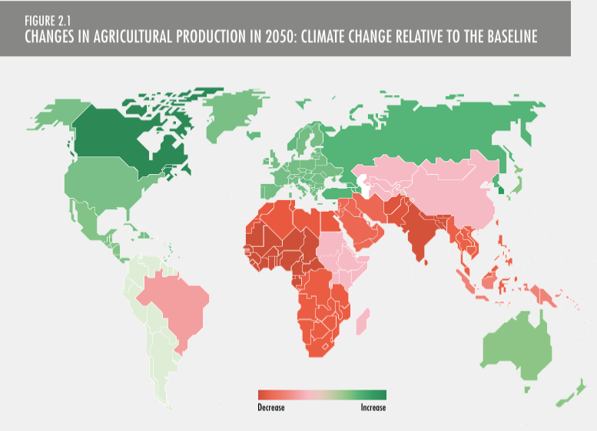
Loss of livelihoods across Asia
Notes:
Climate change is predicted to cause significant loss of livelihoods in Asia, particularly in South and Southeast Asia, by threatening agricultural productivity, increasing extreme weather events like floods and storms, and raising sea levels. You can see in the map the predicted changes in agricultural production in 2050.
Projections indicate millions could be pushed into poverty and food insecurity, while coastal communities and workers dependent on agriculture and fisheries face impending displacement and economic disruption.

Slide 6
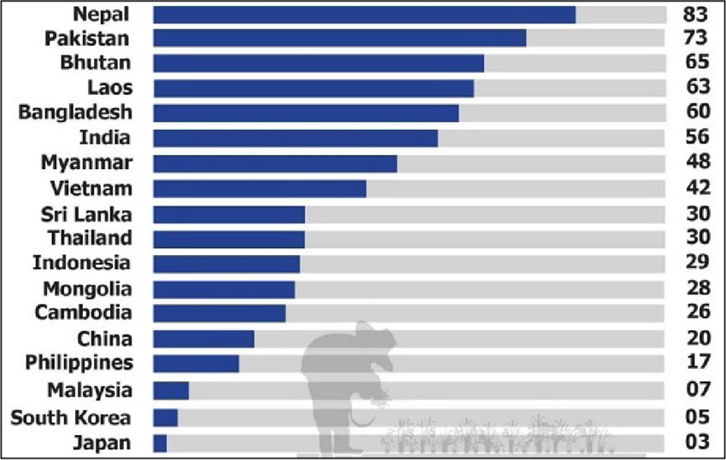
Impacts on women’s livelihoods
Percentage of women Involved in agriculture across Asia
Notes:
Women’s livelihoods are particularly vulnerable to climate change in Asia.
Women make up a large share of agricultural labour, which is highly exposed to climate variability. Women are also engaged in small‐scale economic activities such as selling produce, fishing, and handicrafts, which are also threatened by the increase in natural disasters. This means that women often face periods of unemployment or underemployment.
In addition, many women in the region are employed in the informal sector – such as home-based work, smallholder farming, or small-scale fisheries – which often lacks social protection, insurance, and legal safeguards. These jobs are highly sensitive to climate impacts like floods, heatwaves, storm damage. Informal employment also means limited ability to shift work in response to climate shocks, and exposure to occupational health risks such as heat stress.

Slide 7
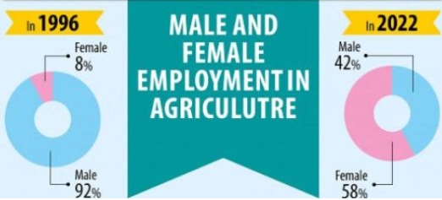
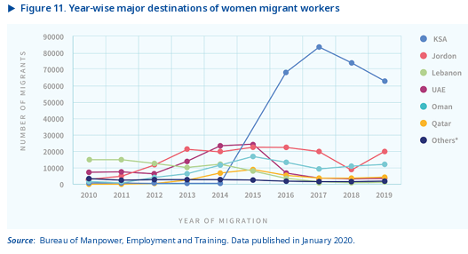
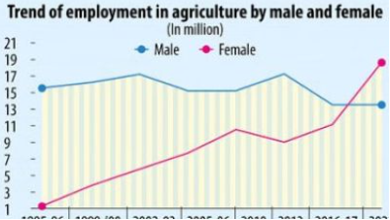
Bangladesh
Notes:
In Bangladesh, women make up over 50% of the agricultural labour force. You can see in the graphs that women’s engagement in farm work has increased 17-fold over the past 2 decades.
As climate shocks have eroded agricultural livelihoods, women have been pushed into precarious labour, poultry farming, or informal work.
Women are more vulnerable to the effects of climate change than men because they rely more heavily than men on unpredictable daily means of subsistence, have fewer coping mechanisms, are more likely to live in poverty, and must contend with social norms and obligations that prohibit them from actively participating in climate change processes. Women have limited access to land and credit.
The number of Bangladeshi women migrants has also grown significantly in recent years, as you can see in the graph on the right. From 2004 to 2017, the number of women migrating from Bangladesh annually rose from approximately 1,259 to 121,925, reflecting a 260% increase (although women are still only 12% of Bangladesh’s overall migrant workforce.) Women work primarily in low-skilled caregiving and domestic roles in the GCC countries.
Many migrants return early: 46% of Bangladeshi workers leave before their contract ends, with 32% unemployed upon return. Wage expectations are often inflated, leading to dissatisfaction. Reintegration challenges are significant.

Slide 8
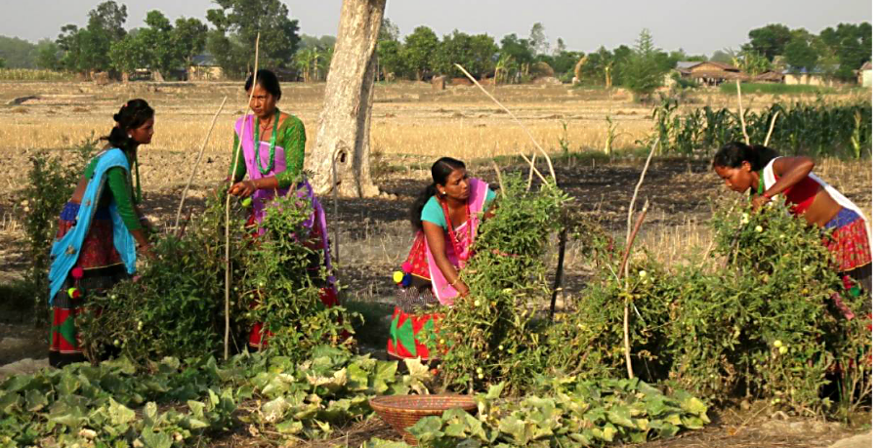
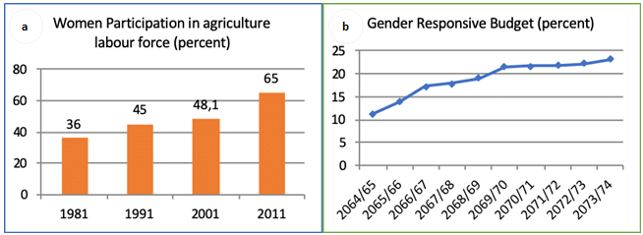
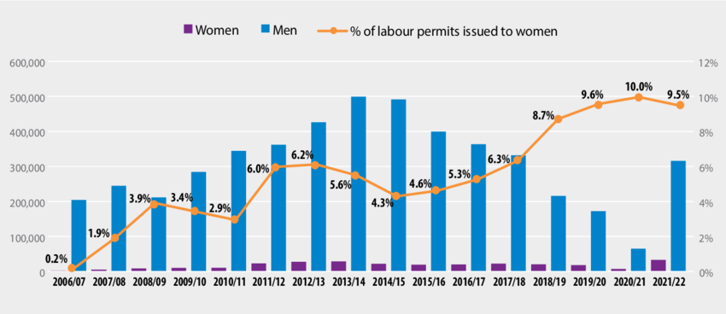
Nepal
Number and proportion of labour permits issued by sex, 2006-2022
Notes:
Women’s employment in the agricultural sector has risen significantly in recent years and women now constitute over 70% of the agricultural labour force in Nepal, typically as day labourers. Women are excluded from many employment opportunities especially in rural areas, which means the majority of women workers have no choice but to engage in small-scale climate-sensitive agriculture or informal work with no safety nets.
Women agricultural workers in Nepal lack financial resources and access to credit, rarely own land, and limited access to education and information, lowering their ability to adapt to climate change. Wealthier households mitigate risks through tenancy and irrigation investments, but this is not available for poorer households, and livelihood loss occurs.
The number of women migrating has increased steadily over time, as the graph shows. In 2025, it is estimated that around 104,000 Nepali women are working in the GCC countries, which is around 8% of the Nepali migrant population. Women work primarily as domestic workers and helpers, cleaners, launderers and manufacturing labourers. Migration has increased since climate change means farming cannot meet even basic needs.
Most women are unemployed upon return (82% in one study). Returnee women face more challenges than men in reintegrating into local labour markets, due to care and domestic responsibilities; lack of decent opportunities; and inability to access existing support services, such as employment programmes and concessional loans.

Slide 9
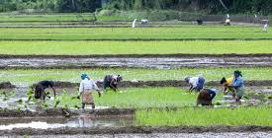
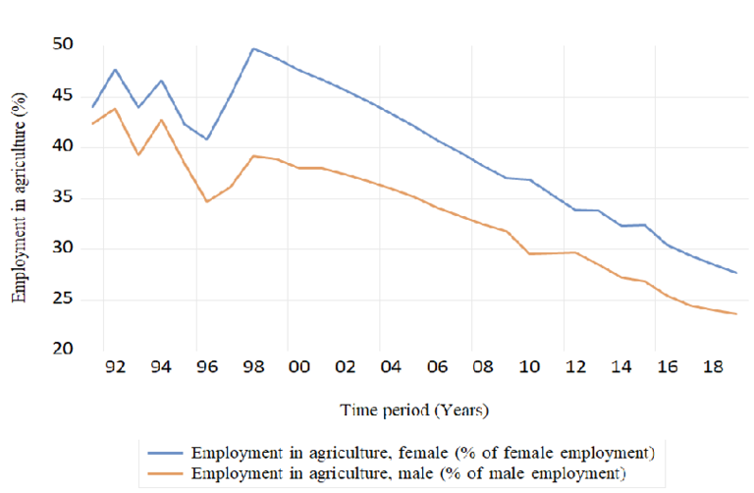
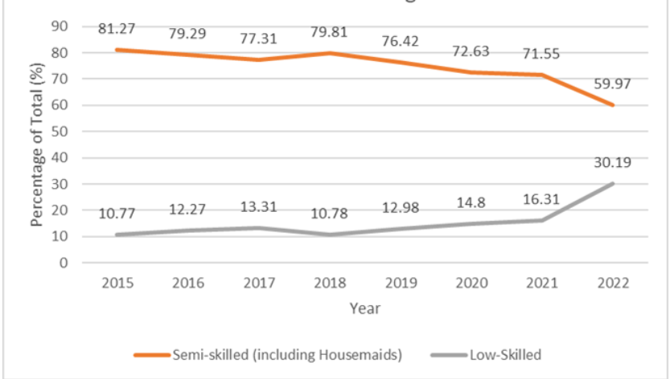
Sri Lanka
Employment in agriculture (% of total employment)
Sri Lankan female migrant workers by skill category
Notes:
The agricultural sector in Sri Lanka has steadily declined over the past 2 decades, but it still provides employment for around 2 million people – and roughly one-third of these are women (680,000 women). Many women grow crops on family-owned land to feed their families, selling any surplus, while others work as farm labourers.
Women who work in agricultural livelihoods already face reduced crop harvests, loss of income, and food insecurity. Because most women do not own land, they do not have access to credit or government subsidies.
While data indicates a sharp decrease in female work migration in the years leading up to 2015, there was an increase in absolute numbers and relative share of female departures from 2016 onwards. The economic crisis of the past few years has continued to drive migration up.
35% of Sri Lankan migrants are women, and in 2022, 124,091 Sri Lankan women migrated for semi-skilled and low-skilled jobs, nearly all to the Middle East.

Slide 10
Factors hindering women’s migration
Skills gap related to foreign employment.
Limited information of their options and of the migration procedures.
Limited economic resources and inability to cover migration costs.
Stigma associated with migrating alone, which can continue after return.
Social expectations such as caregiving or childrearing.
Notes:
Climate change impacts are already causing women in Bangladesh, Nepal, and Sri Lanka to lose their livelihoods - but this does not automatically mean that women will migrate, or that migration will offer a safe and dignified adaptation option.
There are also social, cultural, and economic factors that hinder migration, and Skills Mobility Partnerships must account for these factors if they are to be successful. IOM’s research will therefore how to address these factors before, during, and after migration.
Some of the factors include:
Skills gap, meaning that women don’t have the right skills to access foreign employment.
Limited information of their options and of the migration procedures.
Limited economic resources and inability to pay the upfront costs associated with migration, such as recruitment fees, documentation, travel, and skills training.
Stigma, especially if they return prematurely due to exploitation or abuse. Traditional norms discourage women from seeking independence through migration, and this stigma deters many women.
Social expectations: Women often carry heavy caregiving responsibilities that constrain options – not just for migration, but also for attending skills training.

Slide 11
What does a Skills Mobility Partnership offer?
 | Origin countries | Destination countries | Private sector | Workers
Role | Training and skills development Negotiate worker’s rights Reintegration and recognition of skills | Migration pathways Recognition of qualifications Decent work conditions Co-invest in training | Identify skills and workforce needs Co-invest in training curriculum Offer jobs Fair recruitment | Training Contractual obligation Reinvest skills on return
Benefit | Reduction in unemployment Remittances Skills transfer | Access to skilled workers Reduced irregular migration | Reliable supply of work-ready employees Reduced training cost | Access to decent jobs Higher wages Professional development
Notes:
Skills Mobility Partnerships (SMPs) aim to fill labour shortages, create safe and regular migration pathways, and foster cooperation between origin and destination countries. A core component of a Skills Mobility Partnership is a bilateral agreement between sending and host country, which combines training, skills recognition, and mobility.
Skills Mobility Partnerships aim to achieve a 'quadruple win': origin, destination, private sector, workers.
Each of the parties plays a key role in making the partnership effective:
Origin countries must invest in training and skills development; negotiate agreements to protect workers’ rights abroad; and facilitate reintegration and recognition of skills when workers return. Origin countries benefit from a reduction in unemployment and underemployment; remittances; skills transfer and improved human capital upon workers’ return.
Destination countries must provide fair and transparent migration pathways; ensure recognition of qualifications; and safeguard decent work conditions and labour rights. They can also co-invest in training programs to ensure they are tailored to their own skills gap. Destination countries benefit from access to workers with the skills required to fill shortages; strengthened bilateral relations; and reduced irregular migration pressures.
Employers and industry bodies must identify skill gaps and workforce needs; co-invest in training curricula and certification aligned to industry standards; offer jobs or apprenticeships; and ensure fair recruitment practices. The private sector benefits from a reliable supply of work-ready employees; reduced training costs at destination; and improved corporate reputation through ethical recruitment.
And finally, workers must participate in training, uphold contractual obligations, and bring back skills and experience that can be reinvested in their home communities. They benefit from access to decent jobs abroad; higher wages; professional development; improved career prospects at home and abroad.

Slide 12
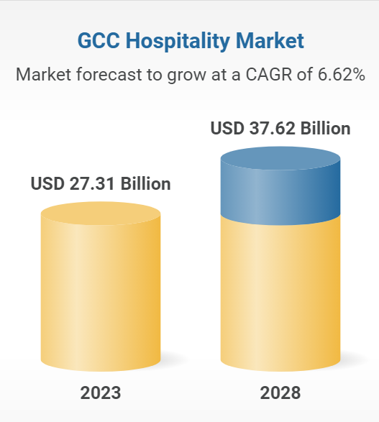
Hospitality sector in GCC countries
Strong demand for hospitality workers in the GCC.
Women migrants are interested to work in the hospitality sector.
Hospitality can build re-employment pathways for returned migrants.
Existing industry initiatives that support women in hospitality.
Notes:
IOM’s research will explore opportunities for skills mobility partnerships in the hospitality sector in the GCC. Why did we decide to focus on hospitality?
There is a strong demand for hospitality workers in the GCC. Tourism is expanding fast, with the World Travel and Tourism Council projecting Middle East travel-tourism to support 7.7m jobs in 2025 and GDP of $367bn. There is multi-year demand certainty, which is ideal for long-term cohorts and employer co-investment.
Women migrants are interested to work in the hospitality sector. There is already an increase in female workers entering hospitality and tourism, and compared to domestic work, hospitality roles provide safer, formalised and better paid options with clearer career pathways.
Hospitality can build re-employment pathways for returned migrants. The same global hotel brands operate at home, with transferable brand standards and internal mobility. Credential and Recognition of Prior Learning systems also exist in Bangladesh, Nepal, and Sri Lanka that can translate GCC experience into local qualifications. Domestic hospitality training ecosystems can also absorb skilled returnees, so returnees can step into higher levels after short, targeted bridging rather than starting over.
And there are existing industry initiatives that support women in hospitality. For example, there is existing hotel-sector specific guidance for labour rights in the GCC, and IOM has a partnership with the World Sustainable Hospitality Alliance to promote ethical recruitment and protect migrant workers in the hospitality industry.

Slide 13
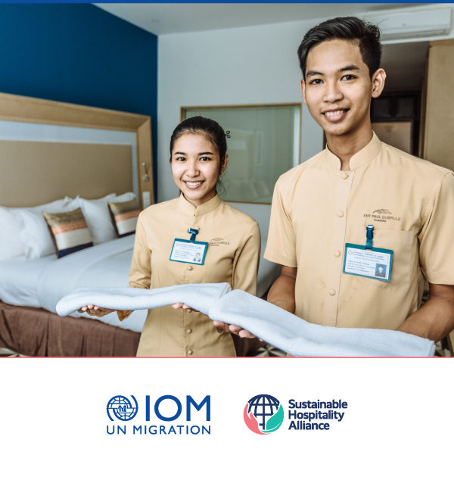
Case study: Sustainable Hospitality Alliance
Training program of 4 weeks theory and 8 weeks practical
IOM to enhance training with AI and ethical recruitment
Member hotels are global chains, present in countries of origin and CoD
Notes:
We will explore at least 1 case study in the research project, to give practical guidance for future Skills Mobility Partnerships.
One case study will look at IOM’s partnership with the World Sustainable Hospitality Alliance. The partnership offers resources such as free online training and guidelines to help hotels implement responsible recruitment practices and address human rights risks.
The Alliance trains women in Africa and Asia in sustainable hospitality, to prepare them to take up entry-level jobs in the GCC. Women who complete the training who have the skills-set to better meet foreign market demands with higher earning potential.
The Alliance already has a training program, comprised of 4 weeks theory and 8 weeks practical training in a member hotel. IOM plans to infuse this training program with additional modules on AI and ethical recruitment. Upskilling in AI is an important facet of the partnership since digital skills are vital for a modern workforce.
Members of the Alliance are global hotel chains who have hotels both in the GCC countries and in Bangladesh, Nepal and Sri Lanka, so there are also potential job pathways for returning migrants.

Slide 14
Recommendations
Skills Development and Recognition
Promote mutual recognition of skills to ease labour mobility across ADD and CP countries.
Establish green skills frameworks aligned with emerging industry demands
Notes:
This research project will produce high-level policy recommendations for labour-sending and receiving countries on the relevance and potential of Skills Mobility Partnerships for women in Bangladesh, Nepal, and Sri Lanka whose livelihoods are impacted by climate change. The policy recommendations will be published in a policy brief in early 2026. Since we are in the early stages of the research, we don’t have the full set of recommendations yet. However, we expect to address 4 areas:
The first area we will address is Skills Development and Recognition. This will include actions such as:
Promote mutual recognition of skills to ease labour mobility across ADD countries.
Establish green skills frameworks aligned with emerging industry demands.

Slide 15
Recommendations
Labour mobility pathways
Creating labour mobility schemes that targets green sector roles which are relevant for both CoO and CoD Developing or expanding bilateral agreements for climate-resilient sectors.
Strengthening pre-departure support, and post-return reintegration pathways.
Notes:
The second area we will address is Labour Mobility Pathways. This will include actions such as:
Creating labour mobility schemes that targets green sector roles.
Developing or expanding bilateral agreements for climate-resilient sectors.
Strengthening pre-departure support, and post-return reintegration pathways.

Slide 16
Recommendations
Public-Private Partnerships and Investment
Employer engagement in training and skills recognition pathways.
Providing incentives to employers in CoO and CoD that hire and train (foreign) women workers.
Facilitating technology transfer and local capacity-building to ensure sustainability.
Notes:
The third area we will address is Public-Private Partnerships and Investment. This will include actions such as:
Employer engagement in training and skills recognition pathways.
Providing incentives to employers that hire and train foreign women workers.
Facilitating technology transfer and local capacity-building to ensure sustainability.

Slide 17
Recommendations
Governance and Standards
Promoting responsible business practices that align with labour and environmental standards.
Encouraging climate-responsive labour governance that mainstreams gender and sustainability into labour policies and mobility frameworks.
Notes:
The final area we will address is Governance and Standards. This will include actions such as:
Promoting responsible business practices that align with labour and environmental standards.
Encouraging climate-responsive labour governance that mainstreams gender and sustainability into labour policies and mobility frameworks.

Slide 18

Thank you. Questions welcome.

